Slide 1

Chapter 19
Domain Name
System
(DNS)
TCP/IP Protocol Suite
Copyright © The McGraw-Hill Companies, Inc. Permission required for reproduction or display.

Slide 2
OBJECTIVES:
To describe the purpose of DNS.
To define the concept of domains and domain name space.
To describe the distribution of name spaces and define zones.
To discuss the use of DNS in the Internet and describe three categories of domains: generic, country, and reverse.
To discuss name-address resolution and show the two resolution methods: recursive and iterative.
To show the format of DNS message and how they can be compressed.
To discuss DDNS and DNSSEC..
TCP/IP Protocol Suite

Slide 3
19-1 NEED FOR DNS
To identify an entity, TCP/IP protocols use the IP address, which uniquely identifies the connection of a host to the Internet. However, people prefer to use names instead of numeric addresses. Therefore, we need a system that can map a name to an address or an address to a name.
TCP/IP Protocol Suite

Slide 4
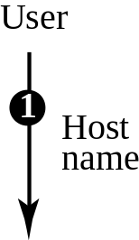
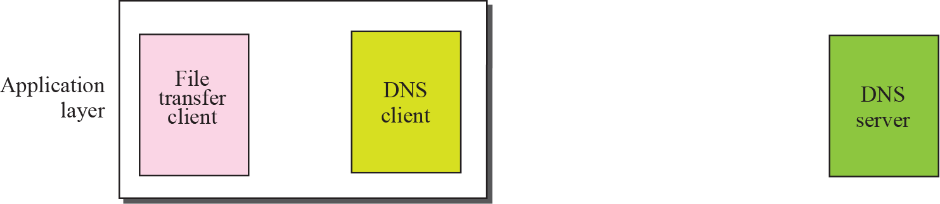
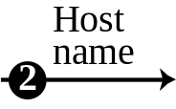
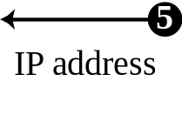
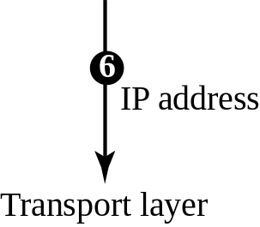
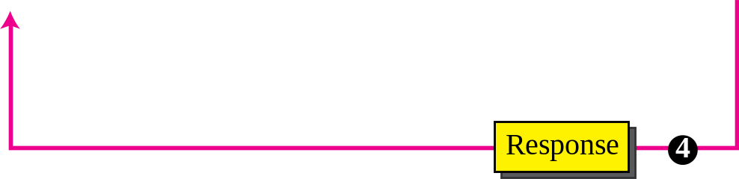
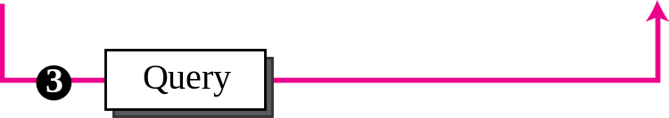
Figure 19.1 Purpose of DNS
TCP/IP Protocol Suite

Slide 5
19-2 NAME SPACE
To be unambiguous, the names assigned to machines must be carefully selected from a name space with complete control over the binding between the names and IP addresses. In other words, the names must be unique because the addresses are unique. A name space that maps each address to a unique name can be organized in two ways: flat or hierarchical.
TCP/IP Protocol Suite

Slide 6
19-3 DNS IN THE INTERNET
DNS is a protocol that can be used in different platforms. In the Internet, the domain name space (tree) is divided into three different sections: generic domains, country domains, and the inverse domain
TCP/IP Protocol Suite

Slide 7
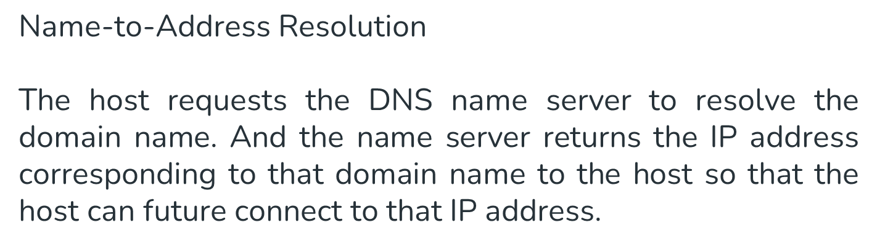
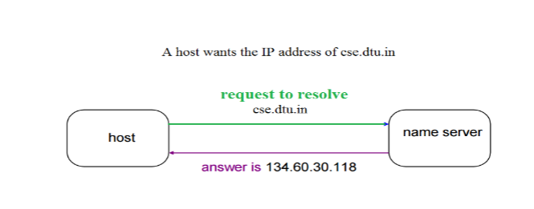
TCP/IP Protocol Suite

Slide 8
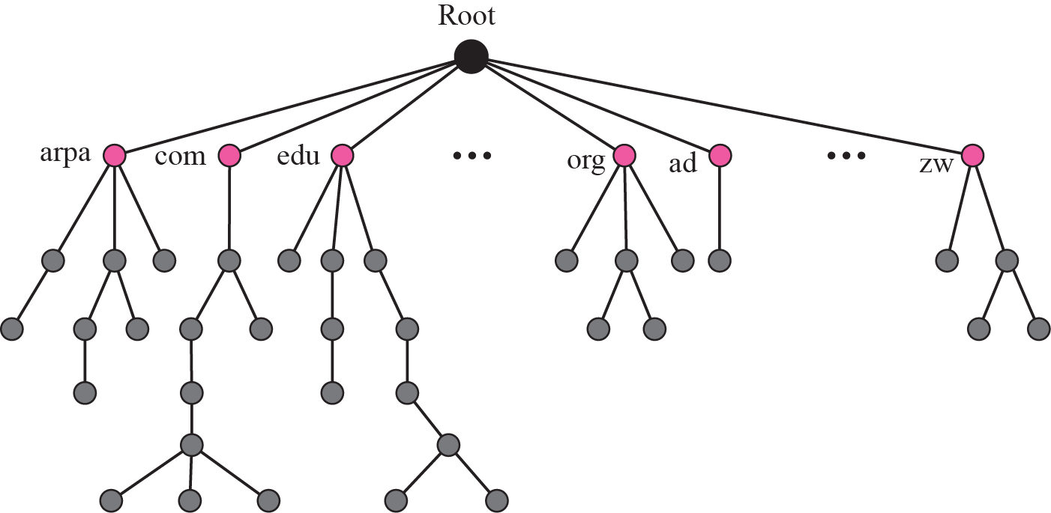
Figure 19.2 Domain name space
TCP/IP Protocol Suite

Slide 9
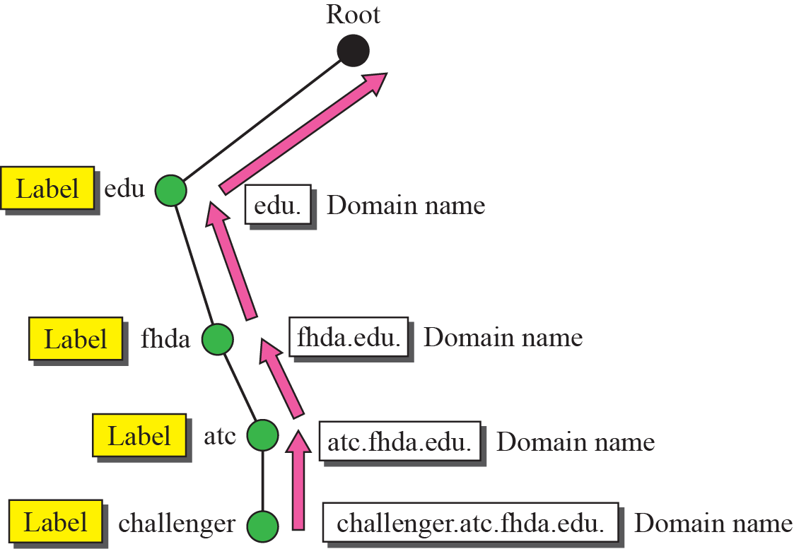
Figure 19.3 Domain names and labels
TCP/IP Protocol Suite

Slide 10
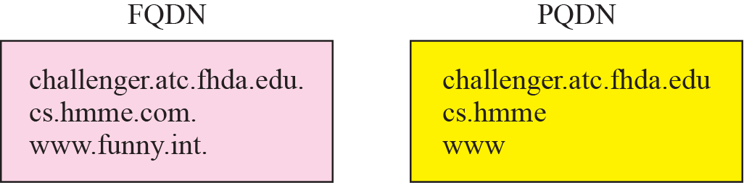
Figure 19.4 FQDN and PQDN
TCP/IP Protocol Suite

Slide 11
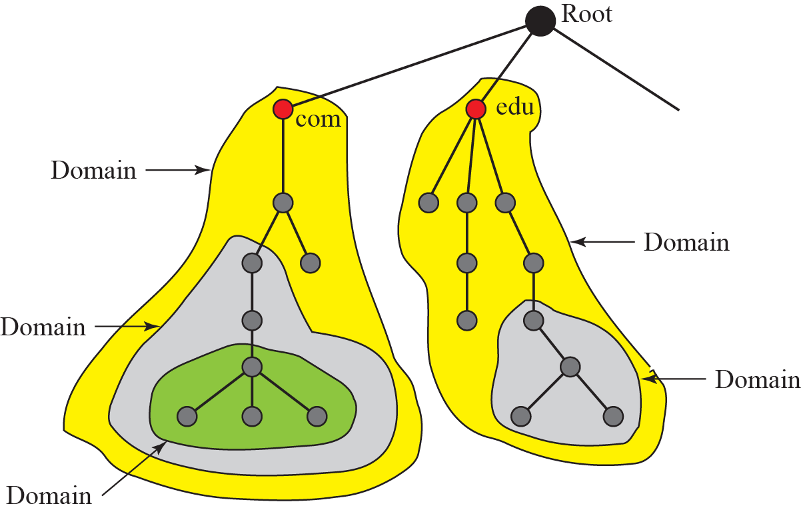
Figure 19.5 Domains
TCP/IP Protocol Suite

Slide 12
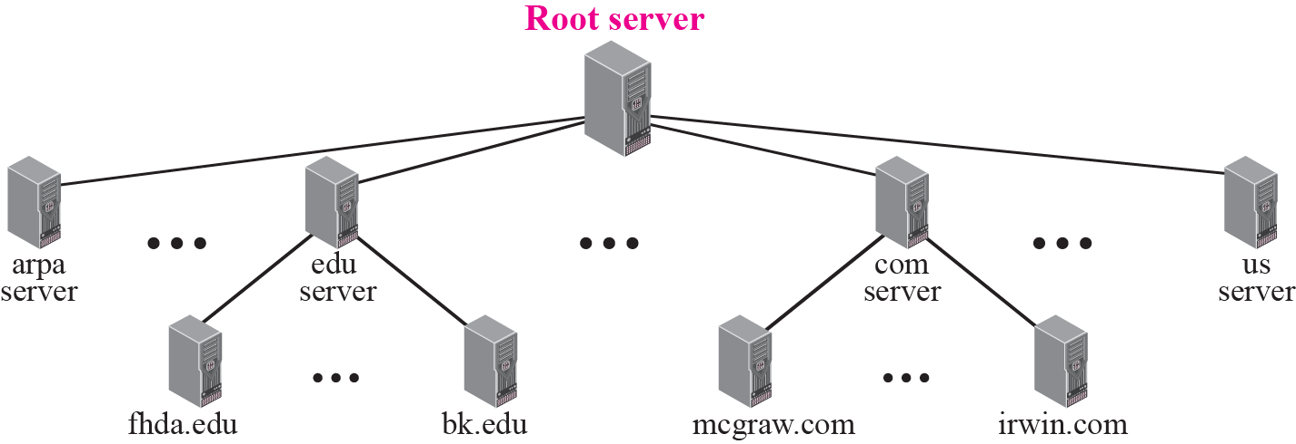
Figure 19.6 Hierarchy of name servers
TCP/IP Protocol Suite

Slide 13
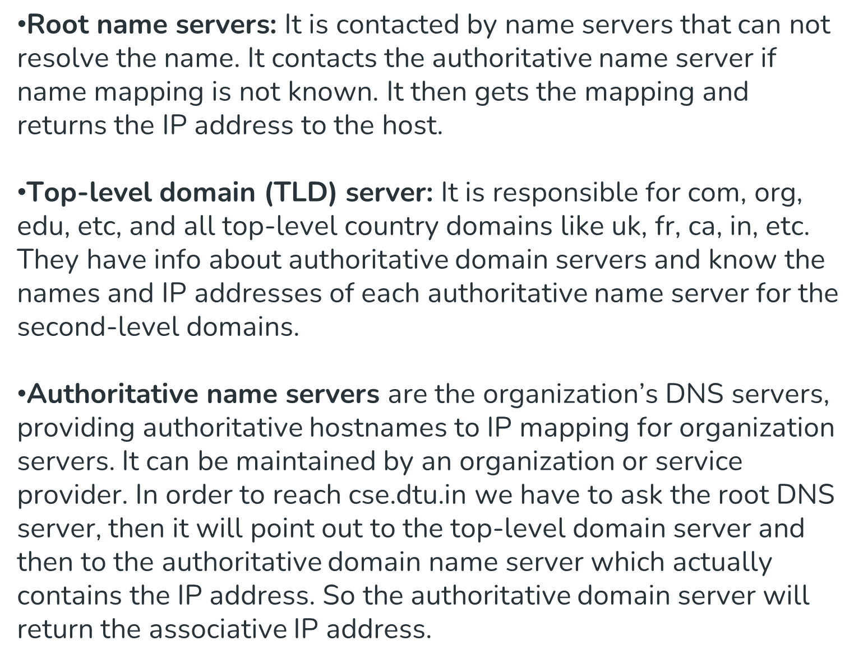
TCP/IP Protocol Suite

Slide 14
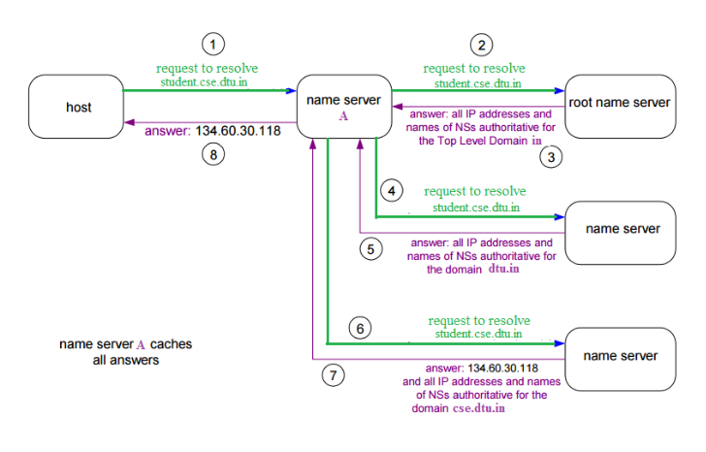
TCP/IP Protocol Suite

Slide 15
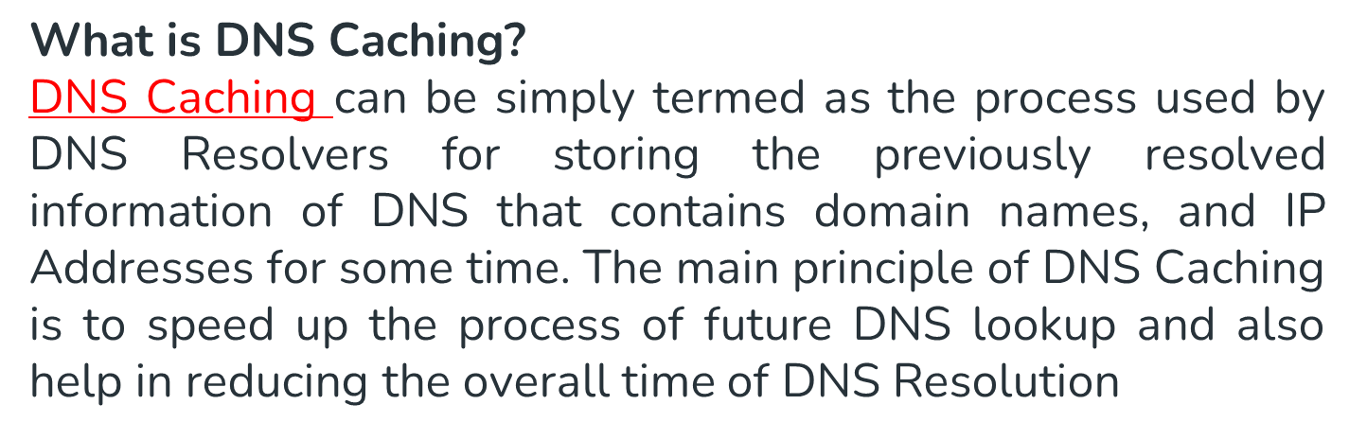
TCP/IP Protocol Suite

Slide 16
19-5 DNS MESSAGES
DNS has two types of messages: query and response. Both types have the same format. The query message consists of a header and question records; the response message consists of a header, question records, answer records, authoritative records, and additional records (see Figure 19.14).
TCP/IP Protocol Suite

Slide 17
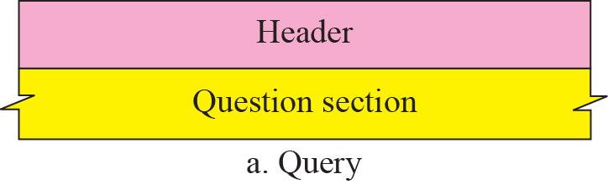
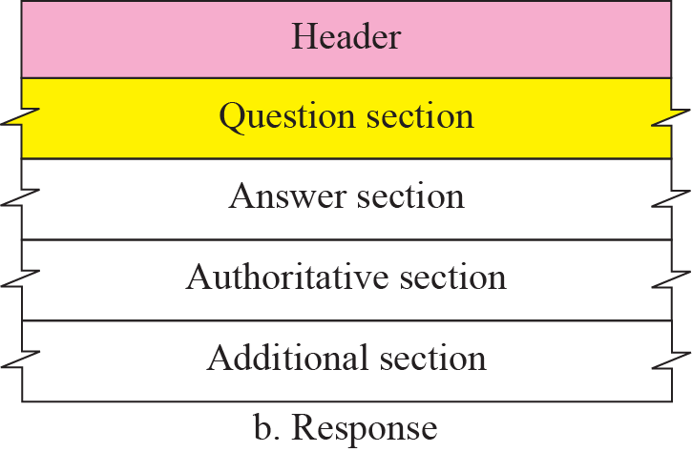
Figure 19.14 Query and response messages
TCP/IP Protocol Suite

Slide 18
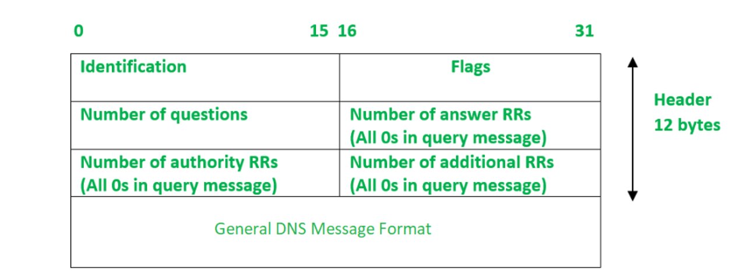
TCP/IP Protocol Suite

Slide 19
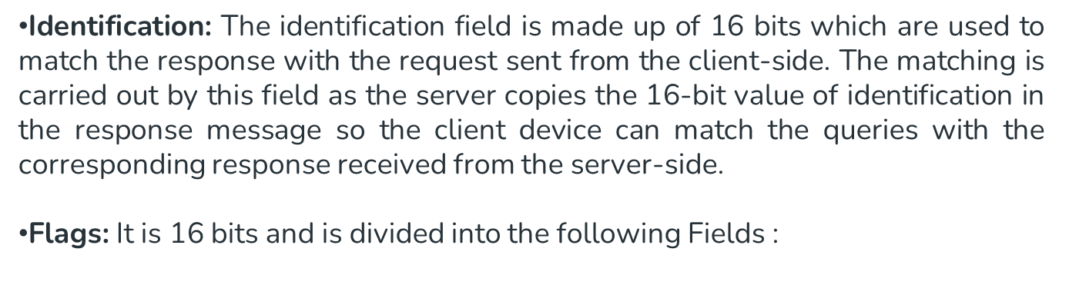
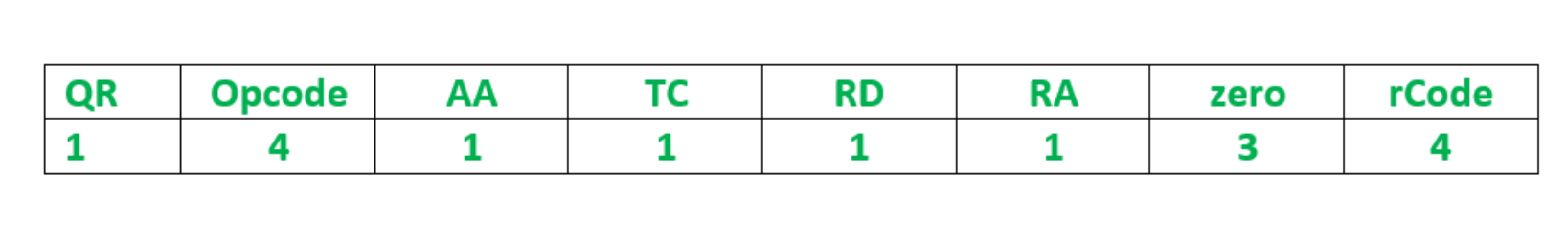
TCP/IP Protocol Suite

Slide 20
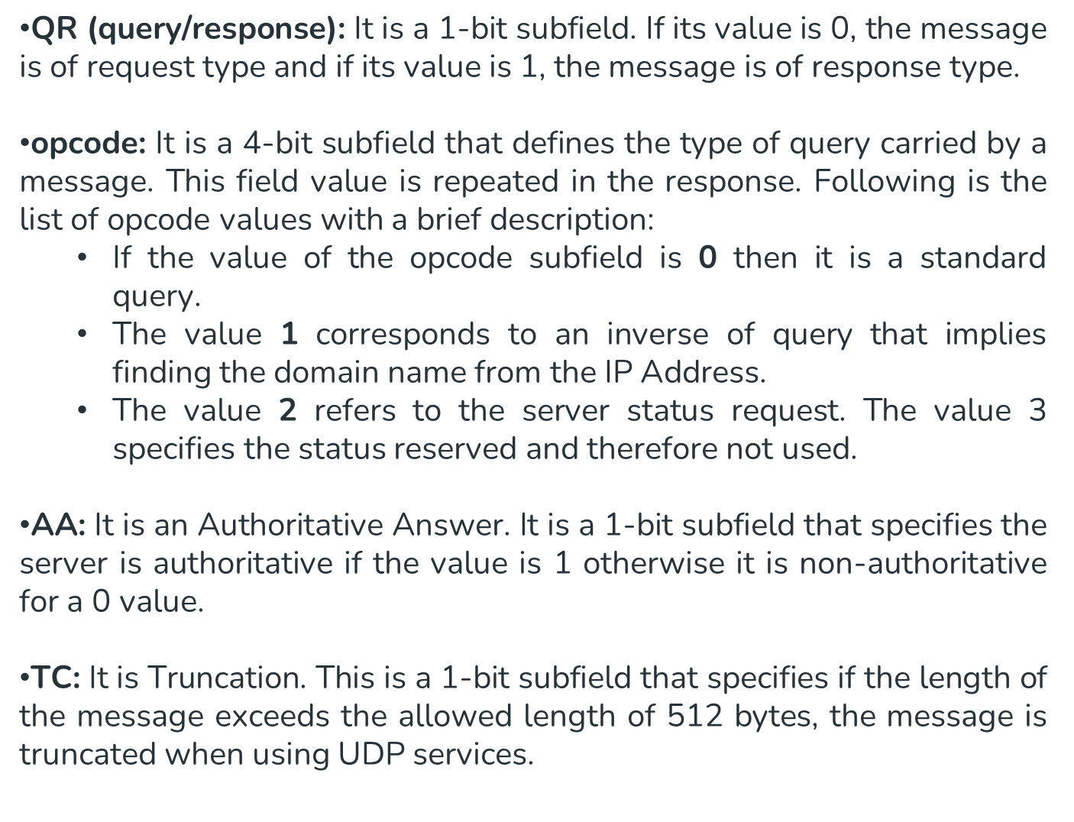
TCP/IP Protocol Suite

Slide 21
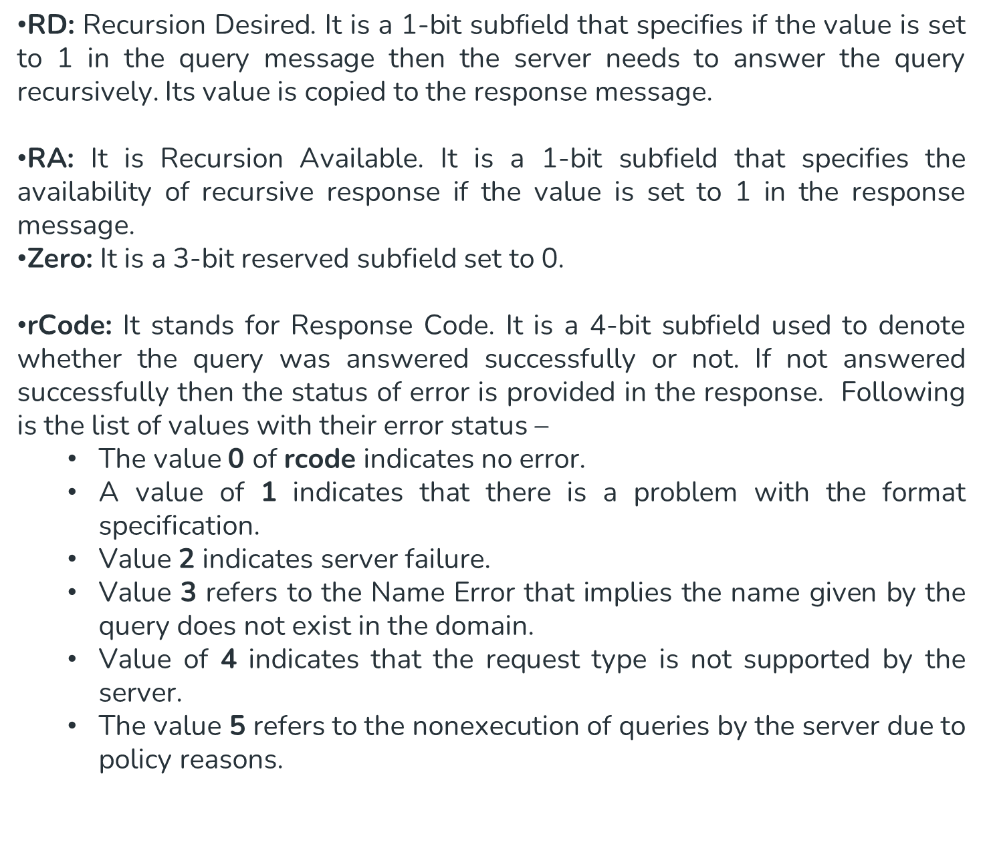
TCP/IP Protocol Suite

Slide 22
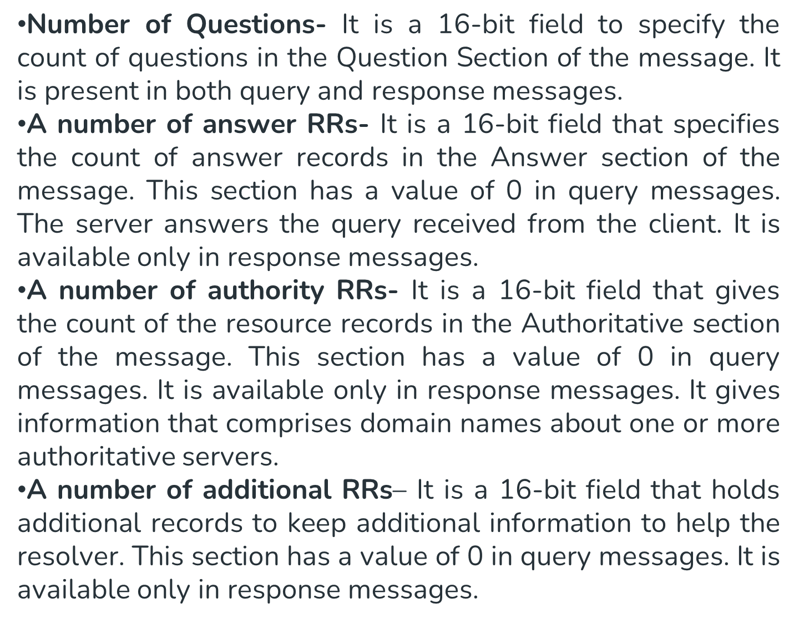
TCP/IP Protocol Suite

Slide 23
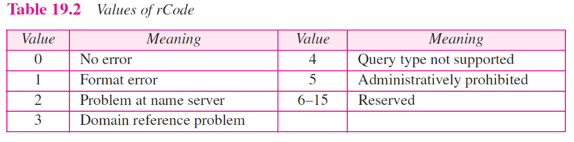
TCP/IP Protocol Suite

Slide 24
19-6 TYPES OF RECORDS
As we saw in the previous section, two types of records are used in DNS. The question records are used in the question section of the query and response messages. The resource records are used in the answer, authoritative, and additional information sections of the response message.
TCP/IP Protocol Suite

Slide 25
Topics Discussed in the Section
Question Record
Resource Record
TCP/IP Protocol Suite

Slide 26
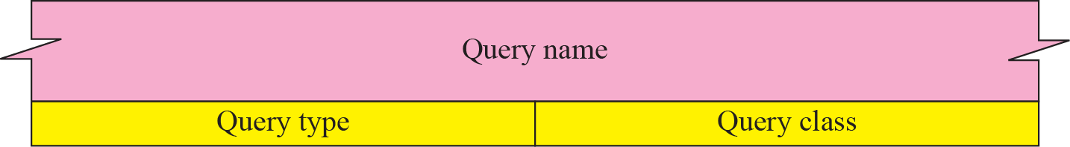
Figure 19.17 Question record format
TCP/IP Protocol Suite

Slide 27
Figure 19.18 Query name format
TCP/IP Protocol Suite

Slide 28
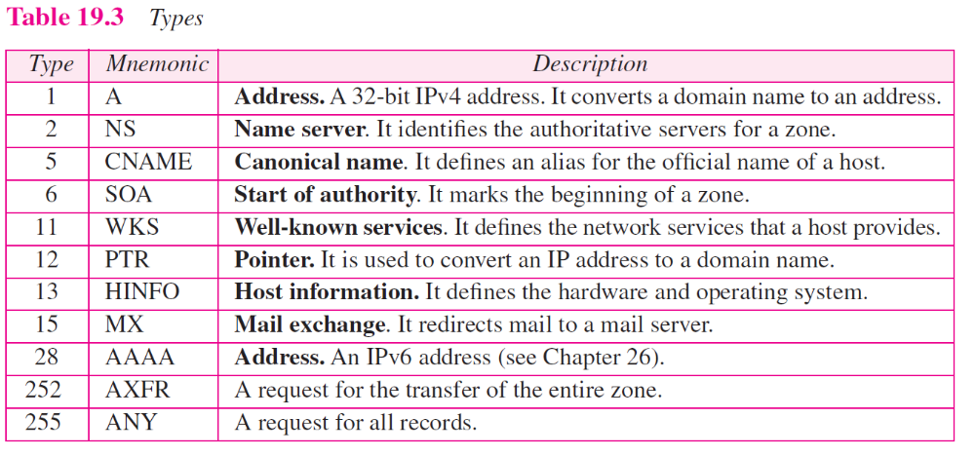
TCP/IP Protocol Suite

Slide 29
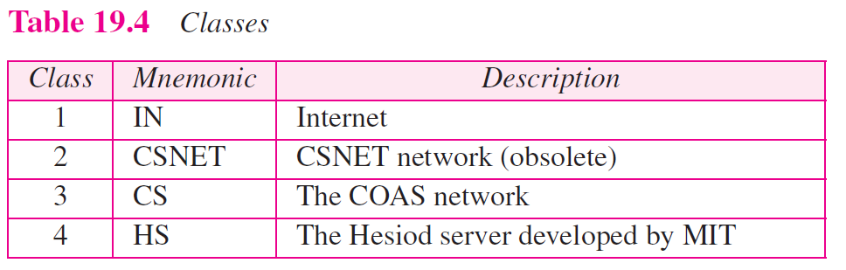
TCP/IP Protocol Suite

Slide 30
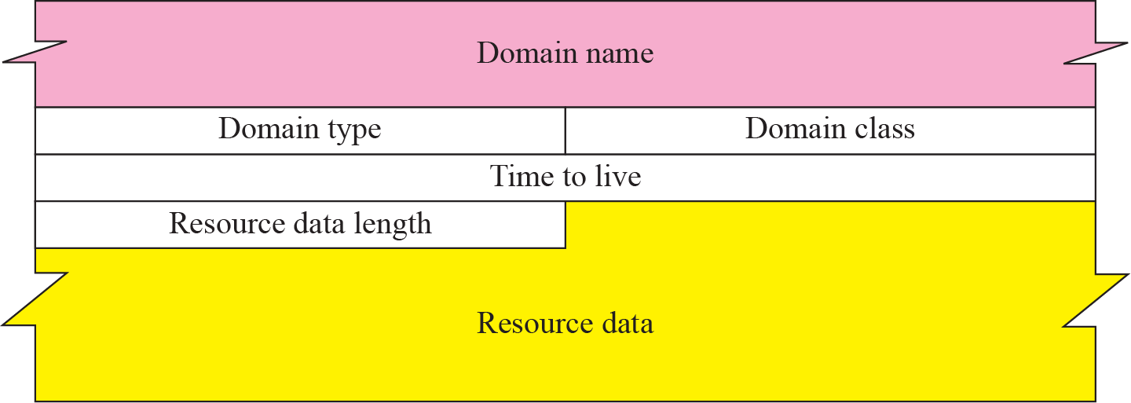
Figure 19.19 Resource record format
TCP/IP Protocol Suite

Slide 31
❑ Domain name. This is a variable-length ﬁeld containing the domain name. It is a duplication of the domain name in the question record. Since DNS requires the use of compression everywhere a name is repeated, this ﬁeld is a pointer offset to the corresponding domain name ﬁeld in the question record. See Section 19.7 on Compression.
❑ Domain type. This ﬁeld is the same as the query type ﬁeld in the question record except the last two types are not allowed. Refer to Table 19.3 for more information.
Domain class. This ﬁeld is the same as the query class ﬁeld in the question record (see Table 19.4).
Time-to-live. This is a 32-bit ﬁeld that deﬁnes the number of seconds the answer is valid. The receiver can cache the answer for this period of time. A zero value means that the resource record is used only in a single transaction and is not cached.
❑ Resource data length. This is a 16-bit ﬁeld deﬁning the length of the resource data.
TCP/IP Protocol Suite

Slide 32
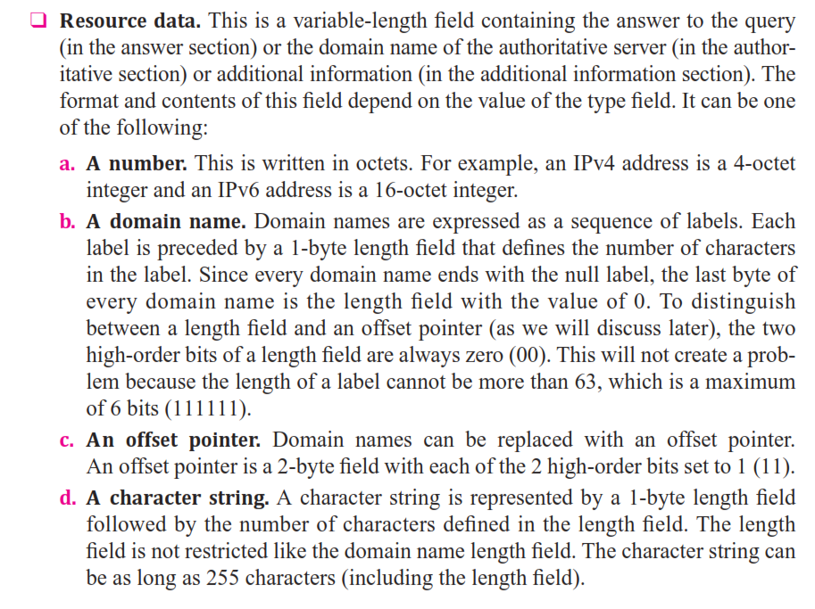
TCP/IP Protocol Suite

Slide 33
Example 19.1
A resolver sends a query message to a local server to find the IP address for the host “chal.fhda.edu.”. We discuss the query and response messages separately. Figure 19.21 shows the query message sent by the resolver. The first 2 bytes show the identifier (1333)₁₆. It is used as a sequence number and relates a response to a query. The next bytes contain the flags with the
value of 0x0100 in hexadecimal. In binary it is 0000000100000000, but it is more meaningful to divide it into the fields as shown below:
TCP/IP Protocol Suite

Slide 34
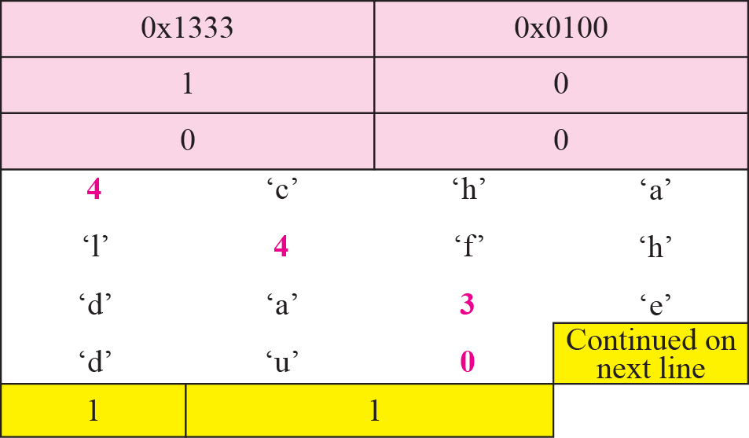
Figure 19.21 Example 19.1: Query message
TCP/IP Protocol Suite

Slide 35
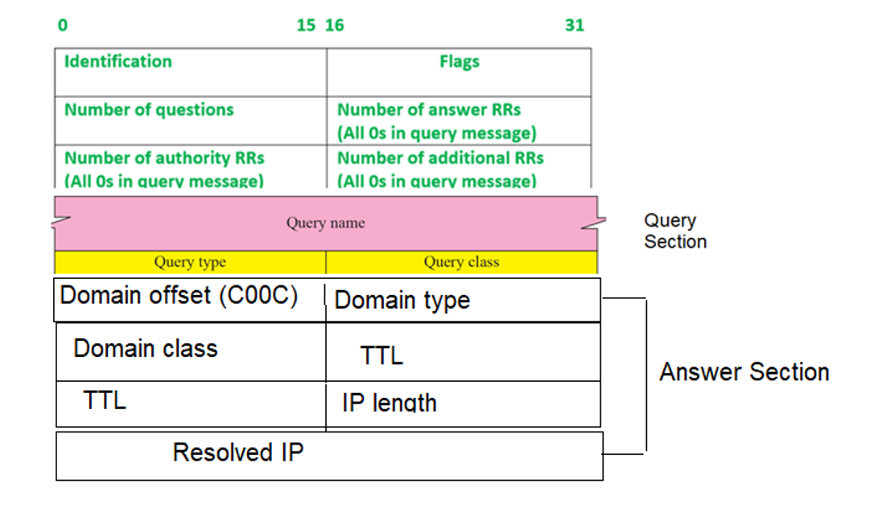
Response Message
TCP/IP Protocol Suite

Slide 36
When the client send a query message asking for resolving, the DNS will reply by the response message. The response message must contain
The DNS header (12 bytes)
The Query section: this is a copy of the same query section in the query message
The answer section or resource record: this contains the following
  Either the domain name as in the query or the offset to the domain name in the query section. In most cases it contains the offset. The offset contains two byte. The first byte is set to C0 and the second is set to C0.
  8 bytes containing
    Domain type (2 bytes)
    Domain class(2 bytes)
    TTL (4 bytes)
  Resource data length: This a two bytes filed containing the length of resolved IP (for IPV4 it is set to 0004)
  The resolved IP (4 bytes)
Important Note: the answer section is repeated for each resolved IP (as per the number of the answer records in the DNS header).
TCP/IP Protocol Suite

Slide 37
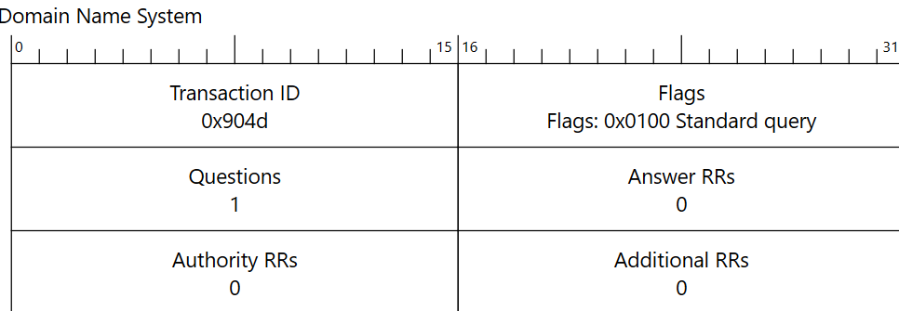
Request Message
90 4d 01 00 00 01 00 00 00 00 00 00
03 77 77 77 06 67 6f 6f 67 6c
65 03 63 6f 6d 00 00 41 00 01
www.google.com
TCP/IP Protocol Suite

Slide 38
cb fc 81 80 00 01 00 01 00 00 00 00
03 77 77 77 06 67 6f 6f 67 6c
65 03 63 6f 6d 00 00 01 00 01
c0 0c 00 01 00 01 00 54 00 04 8e fb 97 77
142.251. 151.119
TCP/IP Protocol Suite

Slide 39
Chapter 22
World Wide Web
and
HTTP
TCP/IP Protocol Suite
Copyright © The McGraw-Hill Companies, Inc. Permission required for reproduction or display.

Slide 40
22-1 ARCHITECTURE
The WWW today is a distributed client-server service, in which a client using a browser can access a service using a server. However, the service provided is distributed over many locations called sites. Each site holds one or more documents, referred to as Web pages. Each Web page, however, can contain some links to other Web pages in the same or other sites. In other words, a Web page can be simple or composite.
TCP/IP Protocol Suite

Slide 41
Example 22.1
Assume we need to retrieve a Web page that contains the biography of a famous character with some pictures, which are embedded in the page itself. Since the pictures are not stored as separate files, the whole document is a simple Web page. It can be retrieved using one single request/ response transaction, as shown in Figure 22.1.
TCP/IP Protocol Suite

Slide 42
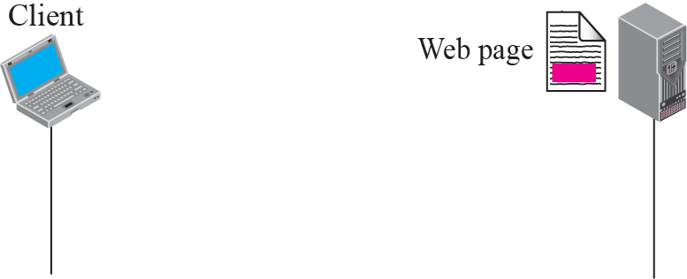
Figure 22.1 Example 22.1
TCP/IP Protocol Suite

Slide 43
Example 22.2
Now assume we need to retrieve a scientific document that contains one reference to another text file and one reference to a large image. Figure 22.2 shows the situation. The main document and the image are stored in two separate files in the same site (file A and file B); the referenced text file is stored in another site (file C). Since we are dealing with three different files, we need three transactions if we want to see the whole document. The first transaction (request/response) retrieves a copy of the main document (file A), which has a reference (pointer) to the second and the third files.
TCP/IP Protocol Suite

Slide 44
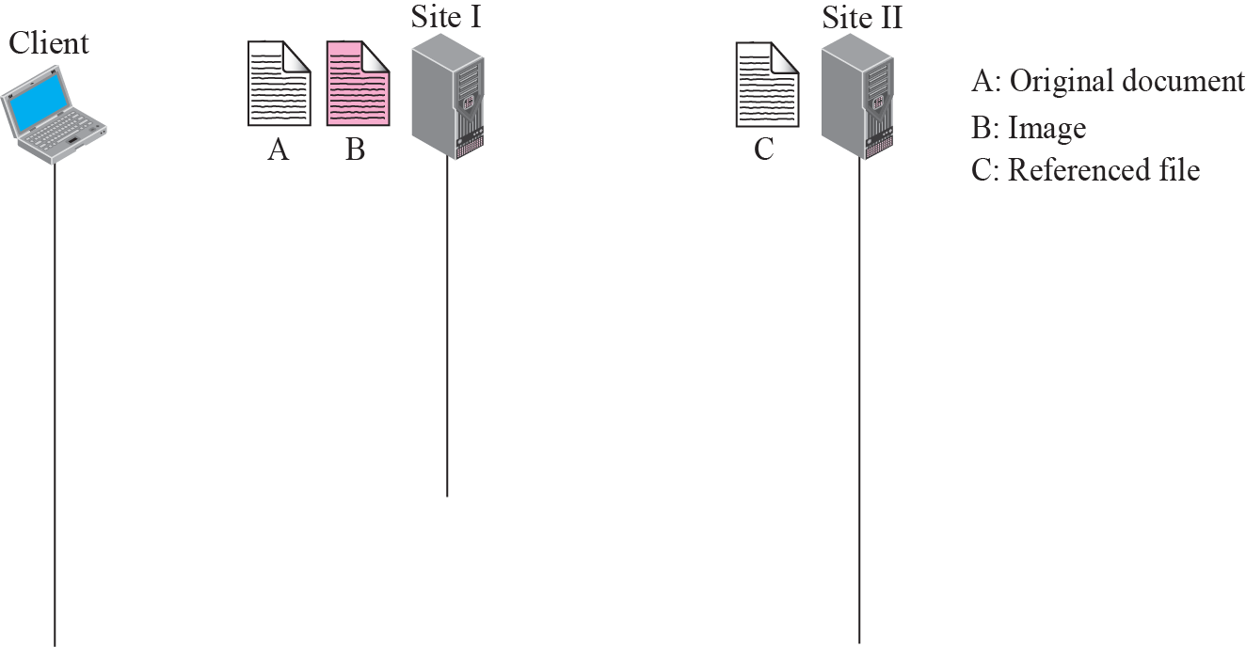




Figure 22.2 Example 22.2
TCP/IP Protocol Suite

Slide 45
22-3 HTTP
The Hypertext Transfer Protocol (HTTP) is a protocol used mainly to access data on the World Wide Web. HTTP functions like a combination of FTP (Chapter 21) and SMTP (Chapter 23). It is similar to FTP because it transfers files and uses the services of TCP. However, it is much simpler than FTP because it uses only one TCP connection. There is no separate control connection; only data are transferred between the client and the server.
TCP/IP Protocol Suite

Slide 46
Topics Discussed in the Section
HTTP Transaction
Conditional Request
Persistence
Cookies
Web Caching: Proxy Server
HTTP Security
TCP/IP Protocol Suite

Slide 47

Note
HTTP uses the services of TCP on well-known port 80.
TCP/IP Protocol Suite

Slide 48
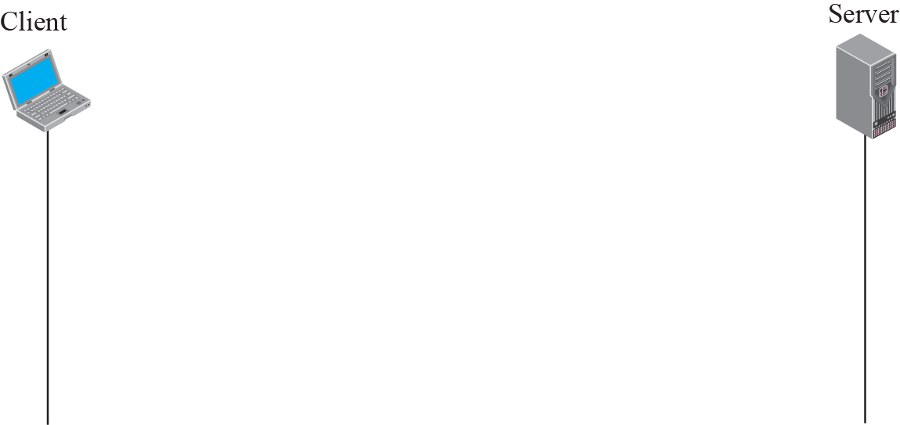
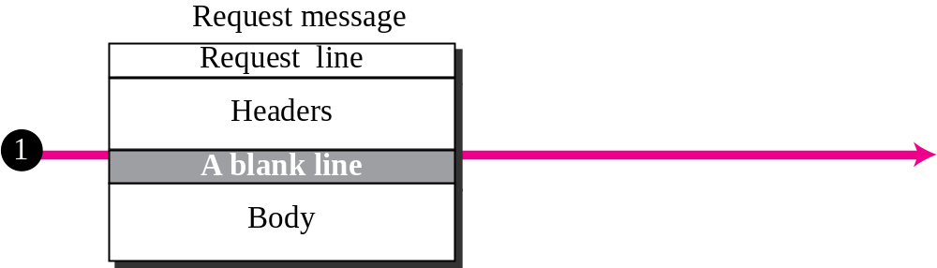
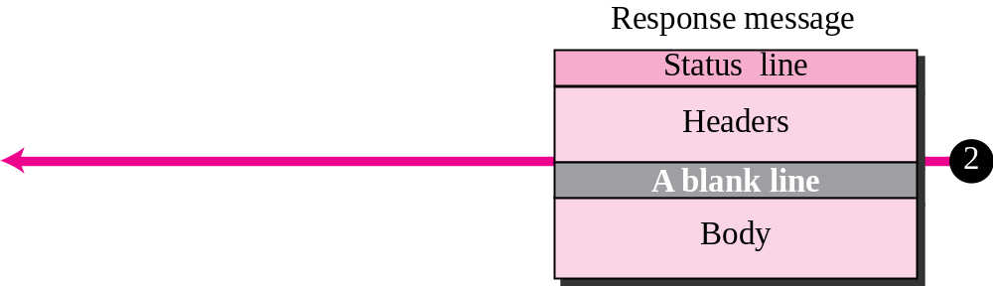
Figure 22.10 HTTP transaction
TCP/IP Protocol Suite

Slide 49
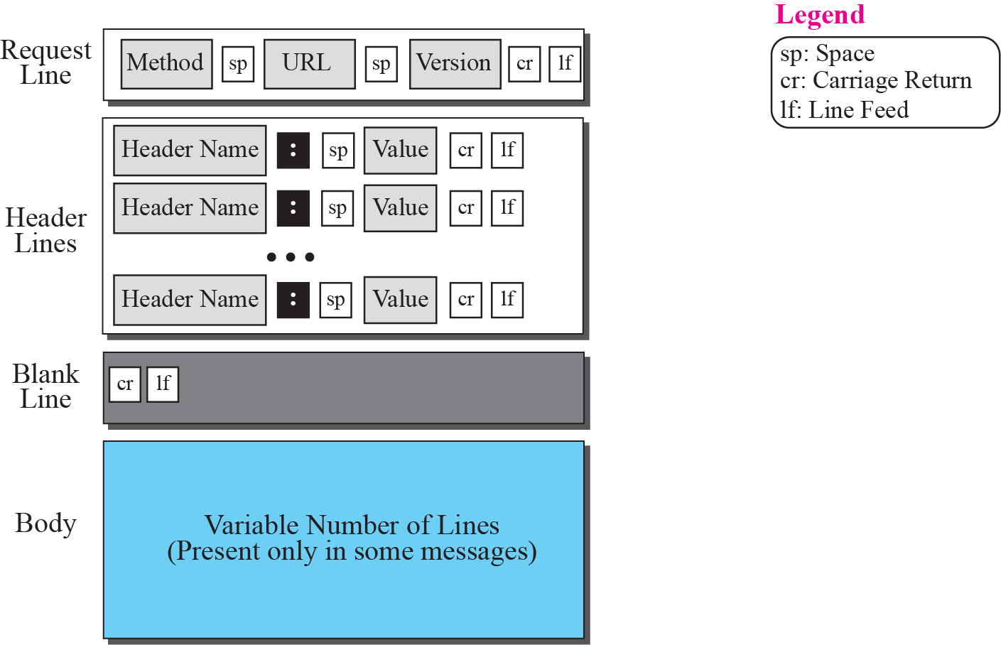
Figure 22.11 Format of the request message
TCP/IP Protocol Suite

Slide 50
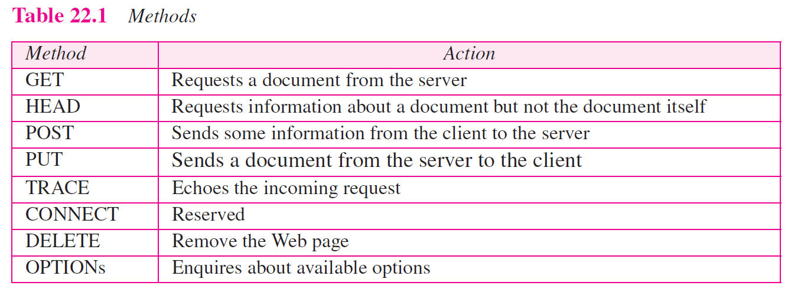
TCP/IP Protocol Suite

Slide 51
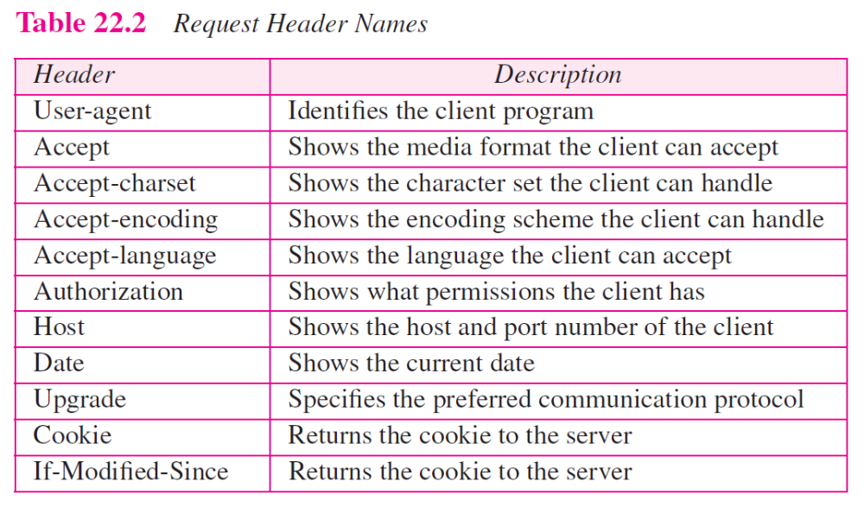
TCP/IP Protocol Suite

Slide 52
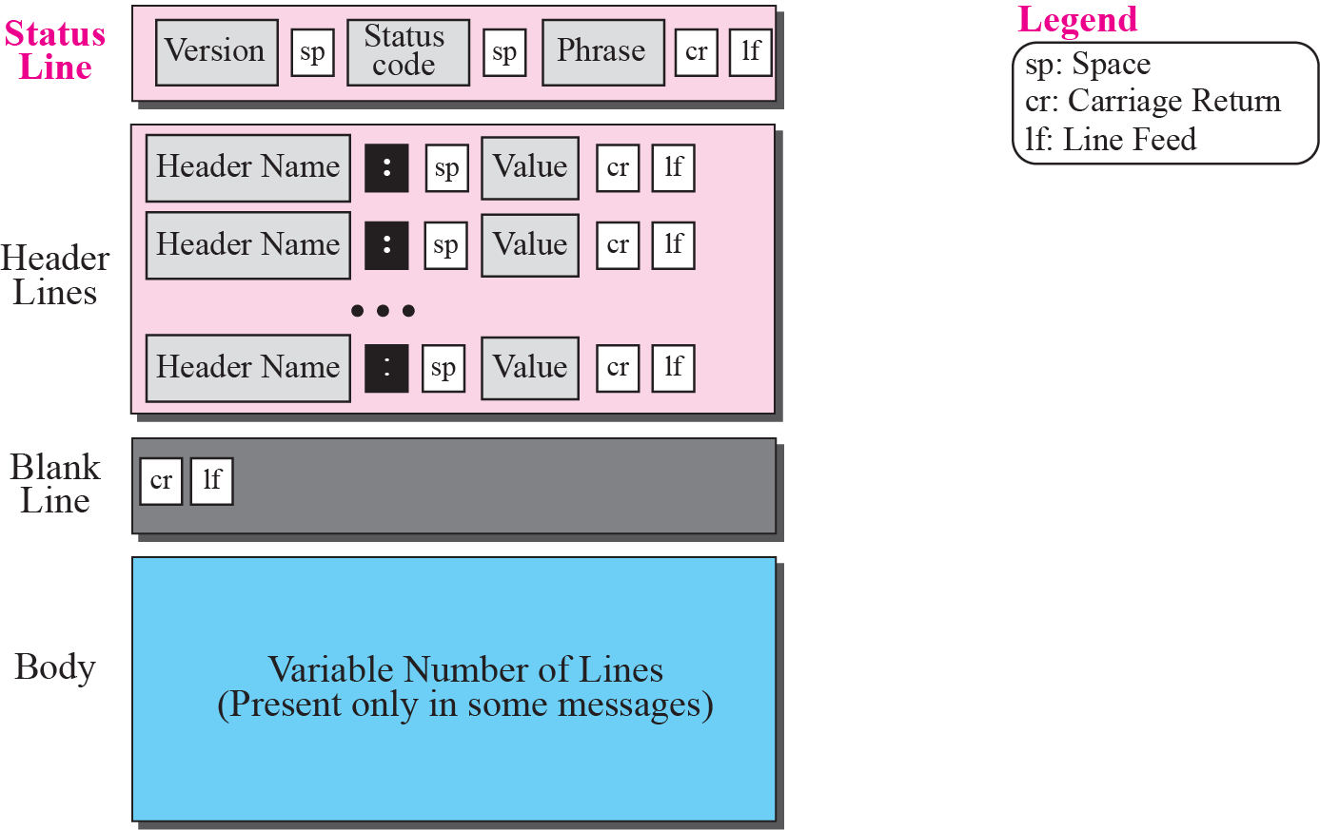
Figure 22.12 Format of the response message
TCP/IP Protocol Suite

Slide 53
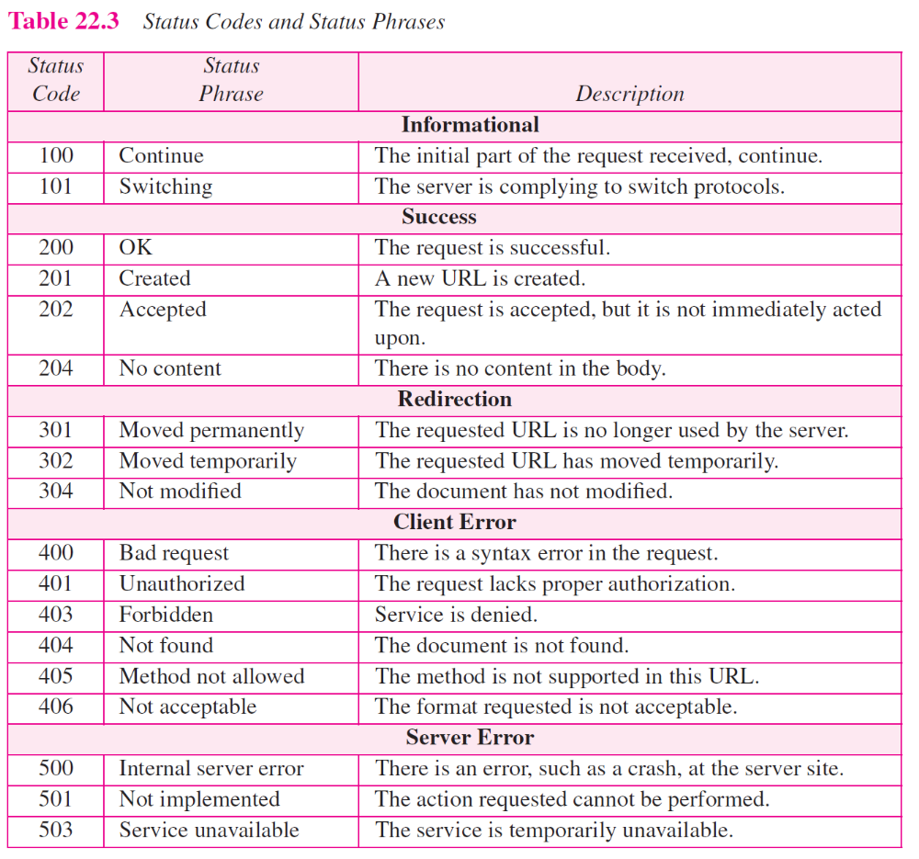
TCP/IP Protocol Suite

Slide 54
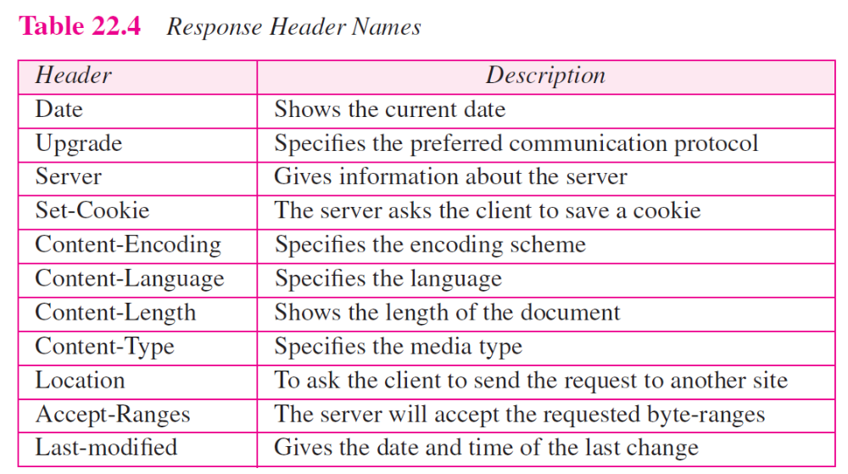
TCP/IP Protocol Suite

Slide 55
Example 22.4
This example retrieves a document (see Figure 22.13). We use the GET method to retrieve an image with the path /usr/bin/image1. The request line shows the method (GET), the URL, and the HTTP version (1.1). The header has two lines that show that the client can accept images in the GIF or JPEG format. The request does not have a body. The response message contains the status line and four lines of header. The header lines define the date, server, MIME version, and length of the document. The body of the document follows the header.
TCP/IP Protocol Suite

Slide 56
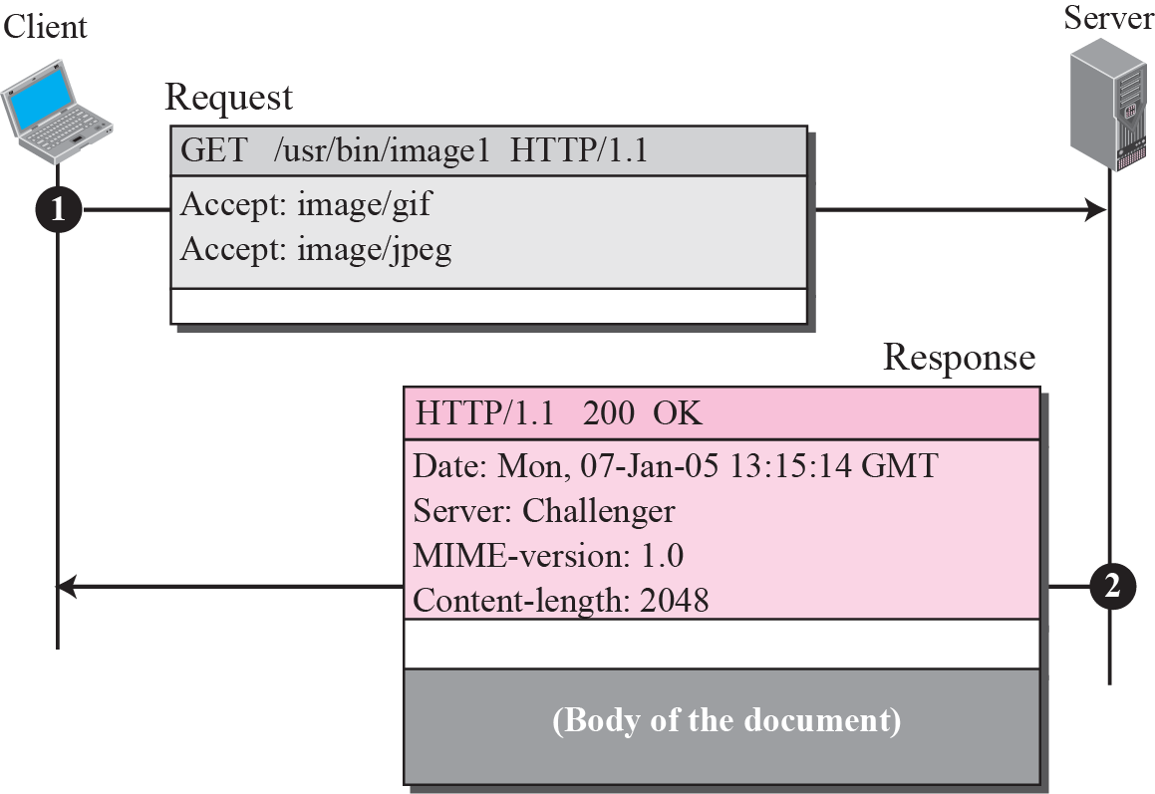
Figure 22.13 Example 22.4
TCP/IP Protocol Suite

Slide 57
Example 22.5
In this example, the client wants to send data to the server. We use the POST method. The request line shows the method (POST), URL, and HTTP version (1.1). There are four lines of headers. The request body contains the input information. The response message contains the status line and four lines of headers. The created document, which is a CGI document, is included as the body (see Figure 22.14).
TCP/IP Protocol Suite

Slide 58
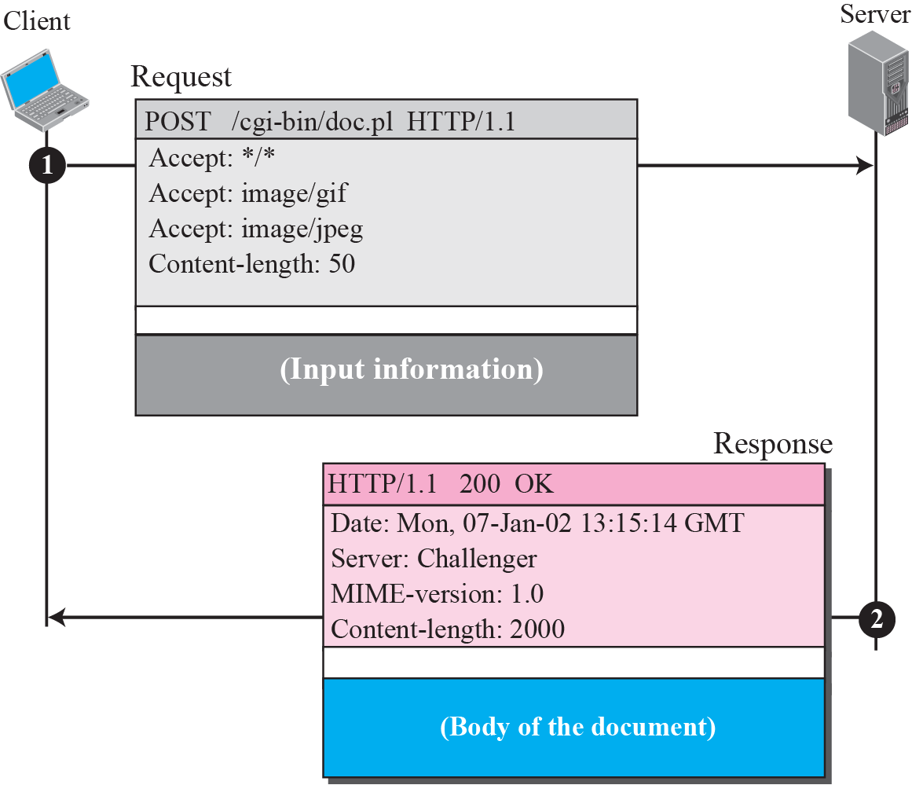
Figure 22.14 Example 22.5
TCP/IP Protocol Suite

